Slide 1



Flipping Bits in Memory Without Accessing Them
DRAM Disturbance Errors
(Row Hammer)
Presented By Dr. West
Totally taken without permission from:
Yoongu Kim
Ross Daly, Jeremie Kim, Chris Fallin, Ji Hye Lee,
Donghyuk Lee, Chris Wilkerson, Konrad Lai, Onur Mutlu
Notes:
Hi, my name is Yoongu Kim. And today, I am presenting "Flipping Bits in Memory Without Accessing Them: An Experimental Study of DRAM Disturbance Errors." This is a work done in collaboration with my co-authors from Carnegie Mellon and Intel.
1

Slide 2
DRAM Chip
Row of Cells
Wordline
Row
Victim Row
Row
Aggressor Row
V_{LOW}
Opened
V_{HIGH}
Closed
Row
Victim Row
Row
Repeatedly opening and closing a row induces disturbance errors in adjacent rows
1
Notes:
A DRAM chip consists of multiple rows of cells, where each row is associated with a wire called the wordline. To access a row, the wordline voltage must be increased, thereby opening the row. After accessing the row, the wordline voltage is decreased, thereby closing the row. But if we repeat this procedure, on the same row, over, and over again, we observed that some cells in adjacent rows lose their data. We refer to the row being accessed as the aggressor, and the rows having errors as its victims. In other words, repeatedly opening and closing a row induces disturbance errors in adjacent rows.
1

Slide 3
Quick Summary of Paper
We expose the existence and prevalence of disturbance errors in DRAM chips of today
110 of 129 modules are vulnerable
Affects modules of 2010 vintage or later
We characterize the cause and symptoms
Toggling a row accelerates charge leakage in adjacent rows: row-to-row coupling
We prevent errors using a system-level approach
Each time a row is closed, we refresh the charge stored in its adjacent rows with a low probability
1
Notes:
Here is a quick summary of our paper.
First, we expose the existence, and the prevalence, of disturbance errors in DRAM chips of today. Among 129 DRAM modules that we tested, we were able to induce errors in 110 modules, all of which were manufactured in 2010 or later.
Second, we characterize the cause and symptoms of disturbance errors. When a row is repeatedly toggled, we show that it accelerates the leakage of charge in adjacent rows, through a coupling effect between the rows.
Third, we prevent errors using a system-level approach. Each time a row is opened and closed, our idea is to refresh the charge stored in the adjacent rows with a low probability, thereby offsetting the leakage effect of disturbance.
1

Slide 4
1. Historical Context
2. Demonstration (Real System)
3. Characterization (FPGA-Based)
4. Solutions
1
Notes:
This is the outline of my talk.
First, I’ll provide the historical context behind DRAM disturbance errors. Second, I’ll demonstrate the errors on real systems. Third, I’ll characterize the errors using an FPGA-based testing platform. And finally, I’ll discuss several potential solutions to prevent the errors.
But, first, let us take a trip down memory lane.
1

Slide 5
A Trip Down Memory Lane
IBM’s patent on DRAM
1968
Intel commercializes DRAM (Intel 1103)
1971
Suffered bitline-to-cell coupling
Bitline
Bitline
“... this big fat metal line with full level signals running right over the storage node (of cell).”
– Joel Karp (1103 Designer)
Interview: Comp. History Museum
Cell
2013
8um
6um
2014
1
Notes:
In 1968, IBM was granted the original patent on DRAM.
And in 1971, Intel commercialized the first DRAM chip, the Intel 1103, which suffered from bitline-to-cell coupling. According to Joel Karp, who was one of its designers, the 1103 had “this big fat metal line with full signals running right over the storage node of the cell.” As a solution, Joel told me that they reduced the width of the bitline and nudged it slightly off to the side.
As you can see, coupling in DRAM has been with us ever since the very first DRAM chips.
1

Slide 6
A Trip Down Memory Lane
IBM’s patent on DRAM
1968
Intel commercializes DRAM (Intel 1103)
1971
Suffered bitline-to-cell coupling
Earliest DRAM with row-to-row coupling
2010
We observe row-to-row coupling
2013
Intel’s patents mention “Row Hammer”
2014
1
Notes:
Forty-two years later, in 2013, we observed row-to-row coupling in off-the-shelf DRAM chips. According to our experiments, the earliest DRAM chips that suffer from this effect date back to 2010. And just this year, in 2014, several Intel patents were published that mention a problem that they say is widely referred to as “Row Hammer” in the industry.
1

Slide 7
Lessons from History
Coupling in DRAM is not new
Leads to disturbance errors if not addressed
Remains a major hurdle in DRAM scaling
Traditional efforts to contain errors
Design-Time: Improve circuit-level isolation
Production-Time: Test for disturbance errors
Despite such efforts, disturbance errors have been slipping into the field since 2010
1
Notes:
So what lessons can we draw from history?
First of all, we learned that coupling in DRAM is not new at all. And if not properly addressed, it could lead to disturbance errors. In fact, coupling in DRAM has been, and continues to be, a major hurdle in DRAM scaling.
Historically, DRAM manufacturers have been employing a two-pronged approach to contain disturbance errors. During design-time, they try to improve circuit-level isolation. And during production-time, they try to test for errors.
Despite their efforts, however, we show that disturbance errors have been slipping into the field since as early as 2010.
1

Slide 8
1. Historical Context
2. Demonstration (Real System)
3. Characterization (FPGA-Based)
4. Solutions
1
Notes:
Now I’ll talk about how disturbance errors can be induced on real systems.
1

Slide 9
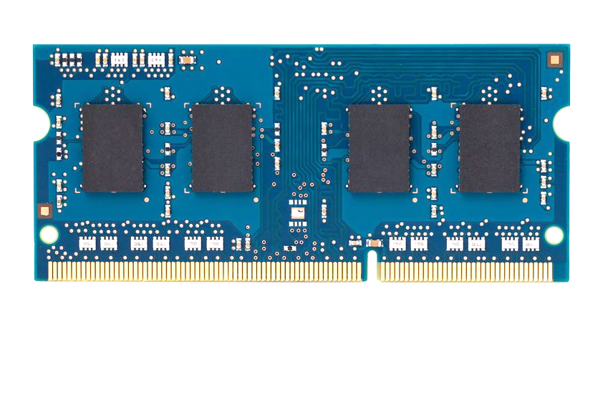
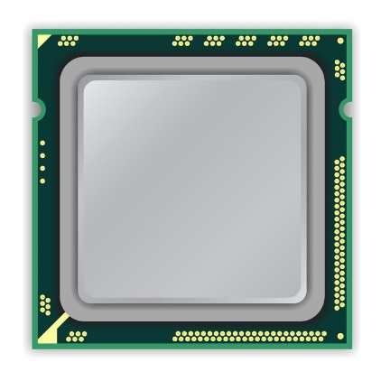
How to Induce Errors
x86 CPU
DRAM Module
DDR3
Avoid cache hits
Flush X from cache
Avoid row hits to X
Read Y in another row
111111111
X
111111111
111111111
111111111
Y
111111111
111111111
Notes:
This is the setup of the system where we induce disturbance errors. It has an x86 processor connected to a DRAM module, which is initially populated with a known data-pattern – in this case, all ‘1’s. Our goal, is to construct a program that repeatedly toggles the row at address X.
However, this cannot be achieved just by issuing many loads to address X. This is because of two reasons. First, cache hits in the processor prevent the load from reaching DRAM. But we can avoid this by flushing X from the cache. Second, when there are consecutive accesses to the same row, the processor keeps the row open without closing it. But we can avoid this by interleaving accesses to two different rows: X and Y.
1

Slide 10
How to Induce Errors
x86 CPU
DRAM Module
DDR3
loop:
mov (X), %eax
mov (Y), %ebx
clflush (X)
clflush (Y)
mfence
jmp loop
001110111
111111111
X
111111111
1111
111111111
101111101
110001011
111111111
Y
1111
111111111
011011110
111111111
Notes:
This is the assembly code that behaves precisely in the manner that I just described. It first opens row X and fetches a cacheline into the processor. But since the next access is to a different row, the processor is forced to close row X before opening row Y. And from row Y, another cacheline is fetched. Subsequently, the two flush instructions evict the cachelines from the processor. Each iteration of the code toggles the two rows X and Y, and after many iterations, many errors appear in adjacent rows.
1

Slide 11
Number of Disturbance Errors
In a more controlled environment, we can induce as many as ten million disturbance errors
Disturbance errors are a serious reliability issue
CPU Architecture | Errors | Access-Rate
Intel Haswell (2013) | 22.9K | 12.3M/sec
Intel Ivy Bridge (2012) | 20.7K | 11.7M/sec
Intel Sandy Bridge (2011) | 16.1K | 11.6M/sec
AMD Piledriver (2012) | 59 | 6.1M/sec
1
Notes:
When we executed the code on four different processors, all four of them yielded errors. Intel Haswell has the most errors, at 23 thousand, because it has the highest rate of accessing DRAM.
Later on, I’ll show that we can induce as many as ten million disturbance errors in a more controlled environment.
From this, we conclude that disturbance errors are a serious reliability issue.
1

Slide 12
Security Implications
Breach of memory protection
OS page (4KB) fits inside DRAM row (8KB)
Adjacent DRAM row → Different OS page
Vulnerability: disturbance attack
By accessing its own page, a program could corrupt pages belonging to another program
We constructed a proof-of-concept
Using only user-level instructions
1
Notes:
In addition, they have serious implications for security
When disturbance errors occur, they could breach memory protection. This is because an OS page fits inside a DRAM row. So an error in a different DRAM row means an error in a different OS page.
This opens up a vulnerability to disturbance attacks. Just by accessing its own page, a malicious program could corrupt pages belonging to another program.
And, as shown previously, we constructed a proof-of-concept using only user-level instructions.
1

Slide 13
Mechanics of Disturbance Errors
Cause 1: Electromagnetic coupling
Toggling the wordline voltage briefly increases the voltage of adjacent wordlines
Slightly opens adjacent rows → Charge leakage
Cause 2: Conductive bridges
Cause 3: Hot-carrier injection
Confirmed by at least one manufacturer
1
Notes:
Why do the errors occur? We see three possible causes.
First, there could electromagnetic coupling between adjacent wordlines. When the voltage of one is toggled, it could briefly increase the voltage of the other and facilitate the leakage of charge.
Two other possibilities are conductive bridges and hot-carrier injection.
At least one manufacturer confirmed that these three could play a role in the disturbance errors we see them today.
1

Slide 14
1. Historical Context
2. Demonstration (Real System)
3. Characterization (FPGA-Based)
4. Solutions
1
Notes:
Now I will characterize the errors.
1

Slide 15

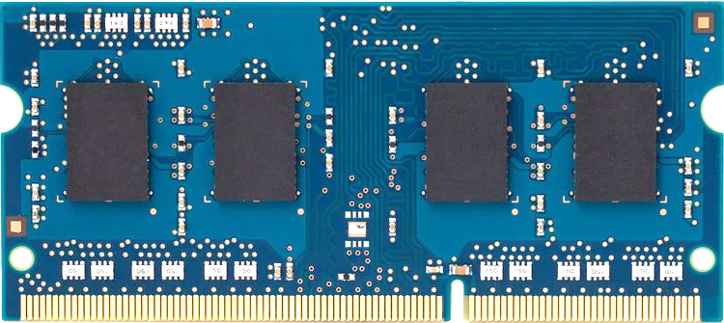
Infrastructure
PC
FPGA Board
Test Engine
PCIe
DRAM Ctrl
1
Notes:
This is the high-level block diagram of our testing infrastructure.
We programmed an FPGA board with a PCIe module, a DRAM controller module, and a custom test engine. The FPGA is connected to a computer, from which we control the FPGAs using a custom software library.
1

Slide 16
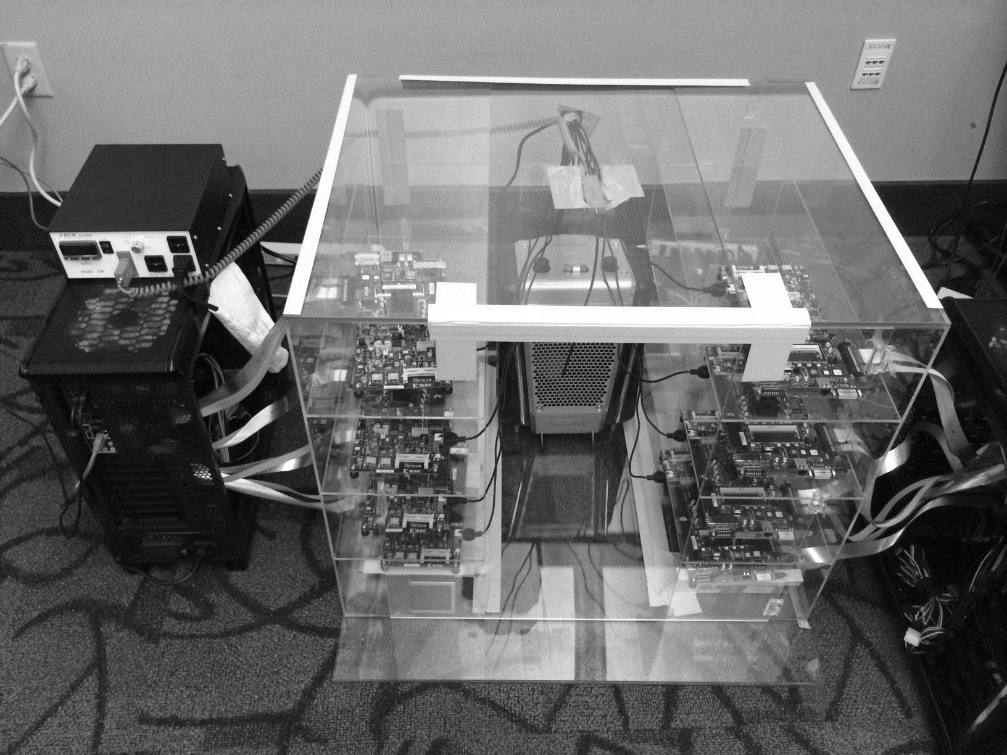
Temperature
Controller
FPGAs
Heater
FPGAs
PC
Notes:
This is the photo of our infrastructure, that we built mostly from scratch.
For higher throughput, we employ eight FPGAs, all of which are enclosed in thermally-regulated environment.
1

Slide 17
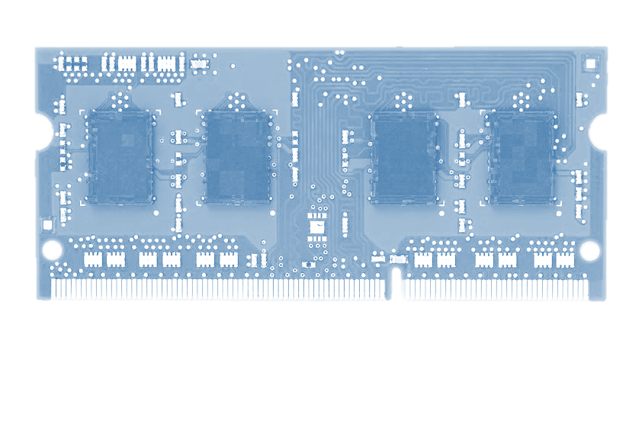
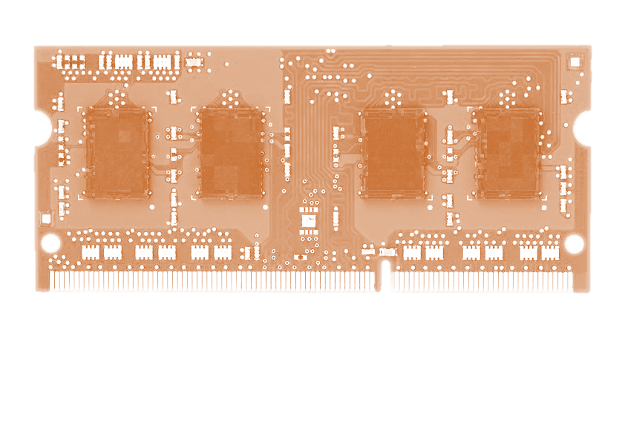
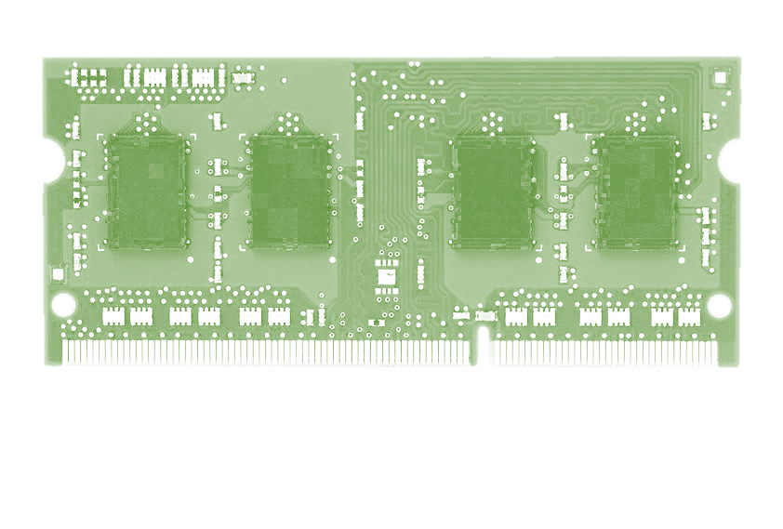
Tested DDR3 DRAM Modules
Company A
Company B
Company C
43
54
32
Total: 129
Vintage: 2008 – 2014
Capacity: 512MB – 2GB
1
Notes:
We tested 129 DRAM modules from thee manufacturers: company A, B, and C.
Their manufacture date ranges from 2008 to 2014. And their capacity ranges from half a gigabyte to two gigabytes.
1

Slide 18
Characterization Results
Most Modules Are at Risk
Errors vs. Vintage
Error = Charge Loss
Adjacency: Aggressor & Victim
Sensitivity Studies
Other Results in Paper
1
Notes:
Now I will present the characterization results, one-by-one.
First, I show that most modules are at risk. Second, I show the number of errors in a module as a function of the manufacture date. Third, I show that the errors are symptomatic of charge loss. Fourth, I show that an aggressor induces errors in adjacent rows. Fifth, I show several sensitivity studies. And, finally, I briefly describe other results in the paper.
1

Slide 19
1. Most Modules Are at Risk
A company
B company
C company
86%
(37/43)
83%
(45/54)
88%
(28/32)
Up to
1.0×10⁷ errors
Up to
2.7×10⁶ errors
Up to
3.3×10⁵ errors
1
Notes:
For all three manufacturers, we were able to induce errors in more than 80% of their modules. And, for some modules, we were able to induce as many as ten million errors. From this, we conclude that most modules are at risk.
1

Slide 20
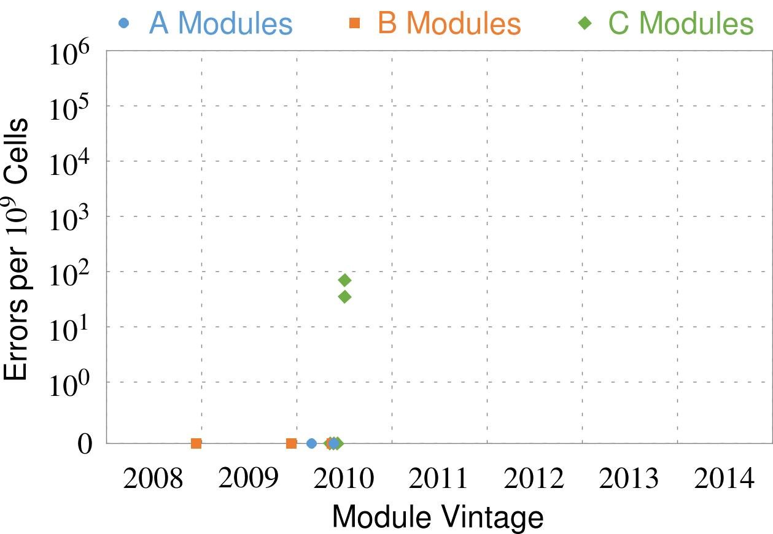
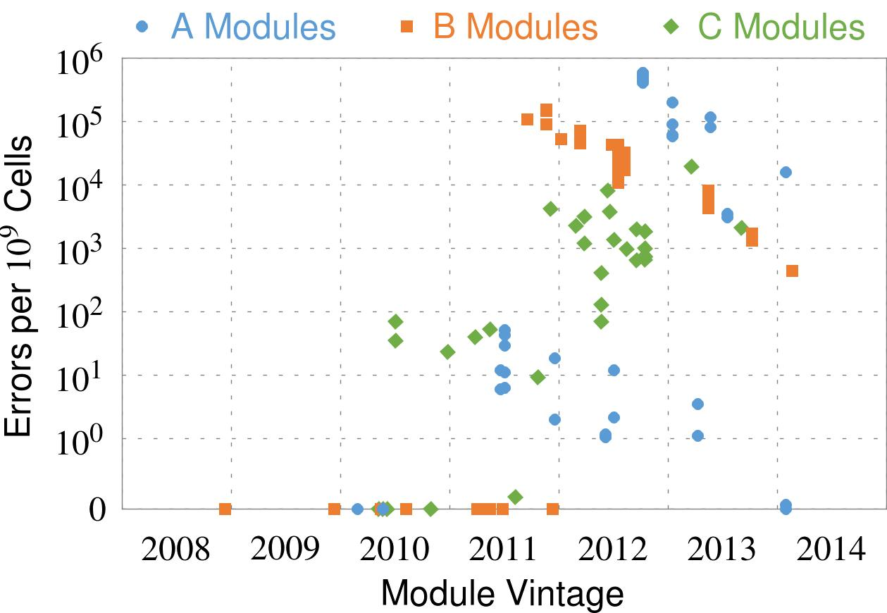
2. Errors vs. Vintage
First
Appearance
All modules from 2012–2013 are vulnerable
1
Notes:
In this figure, the x-axis is the module manufacture date. And the y-axis is the number of errors in a module, normalized to one billion cells. In 2008 and 2009, there are no errors. But, in 2010, we first start to see errors in C modules. After 2010, the errors start to proliferate. For A and B modules, we first start to see errors in 2011. In particular, all modules from 2012 and 2013 are vulnerable.
1

Slide 21
3. Error = Charge Loss
Two types of errors
‘1’ → ‘0’
‘0’ → ‘1’
A given cell suffers only one type
Two types of cells
True: Charged (‘1’)
Anti: Charged (‘0’)
Manufacturer’s design choice
True-cells have only ‘1’ → ‘0’ errors
Anti-cells have only ‘0’ → ‘1’ errors
Errors are manifestations of charge loss
1
Notes:
Depending on which way a bit flips, there are two types of errors: one to zero and zero to one. However, we observed that a given cell suffers from only type of error.
This is closely related to an intrinsic property of DRAM cells called orientation. There are two types of DRAM cells. True cells use the charged state to represent a data of ‘1’, whereas anti cells use the charged state to represent a data of ‘0’. And it is entirely up to the manufacturers to decide which types of cells they implement.
We found that true-cells have only one to zero errors, and that anti-cells have only zero to one errors. From this, we conclude that the errors are manifestations of charge loss.
1

Slide 22
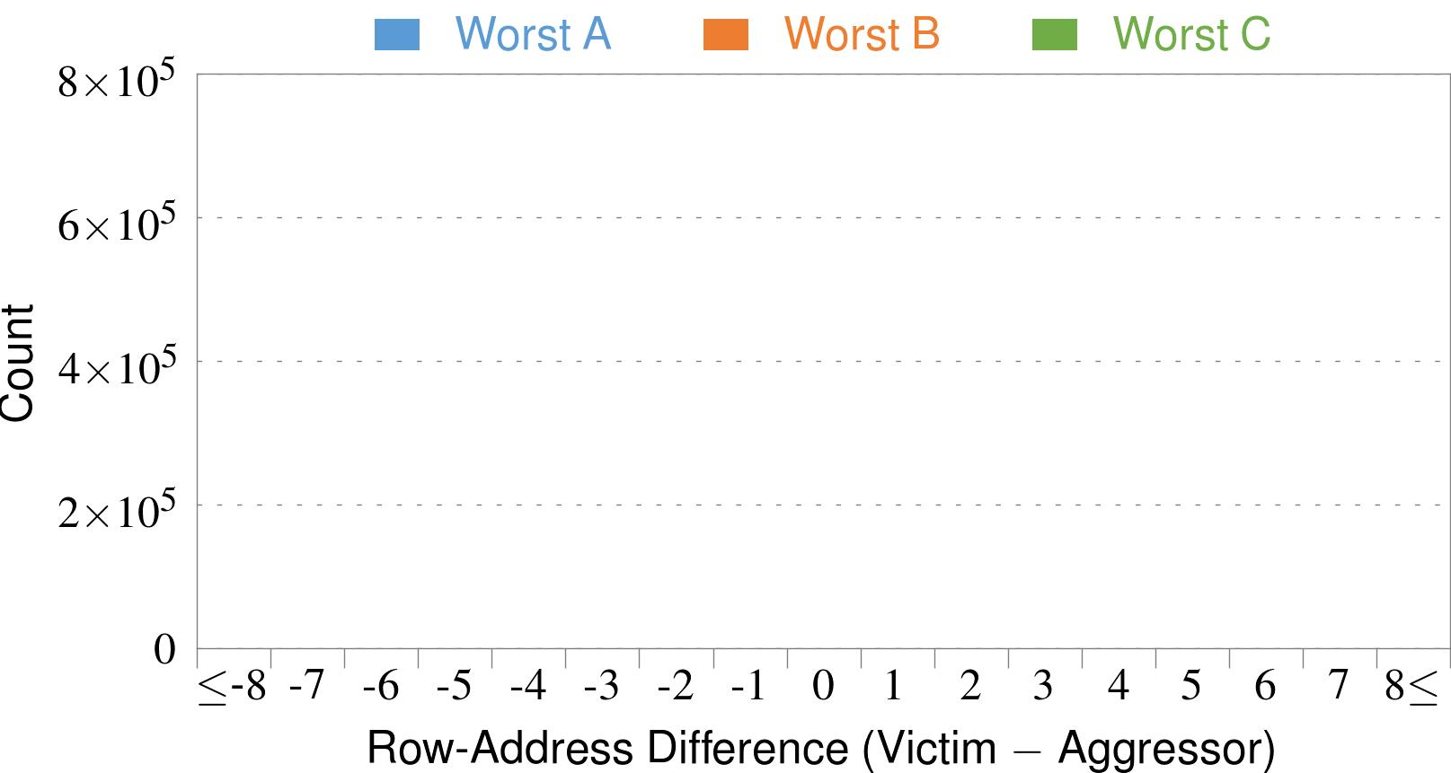
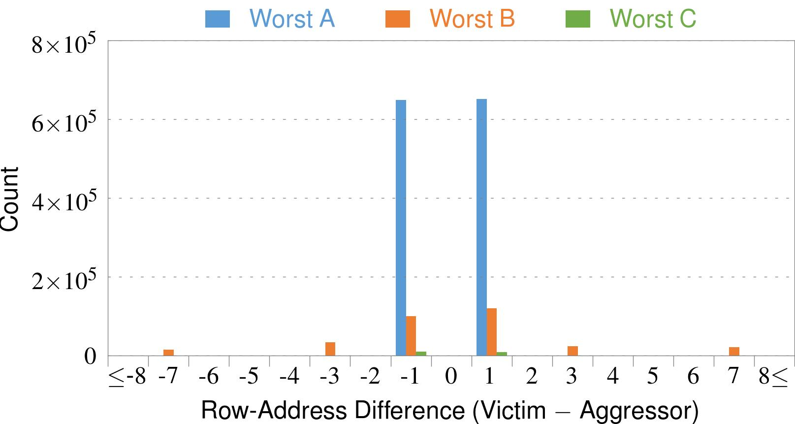
4. Adjacency: Aggressor & Victim
Adjacent
Adjacent
Adjacent
Non-Adjacent
Non-Adjacent
Note: For three modules with the most errors (only first bank)
Most aggressors & victims are adjacent
1
Notes:
In this figure, the x-axis is the row-address difference between an aggressor and its victims. And the y-axis is the number of victim-aggressor pairs that correspond to the row-address difference. For all three modules, we see strong peaks at plus/minus 1. This implies that aggressors and victims have consecutive row-addresses, in other words, they are adjacent.
However, the figure also shows some victims that are not adjacent to the aggressor. We believe this could be caused by two reasons. First, depending on the mapping, two rows that are physically adjacent within the DRAM chip may not have consecutive row-addresses. Second, fault rows are often re-mapped to spare rows that may reside on a different portion of the DRAM chip.
Nevertheless, we conclude that the vast majority of aggressors & victims are adjacent.
1

Slide 23
5. Sensitivity Studies
time
Test Row 0
Test Row 1
Test Row 2
···
Fill Module
with Data
Open
Open
···
Find Errors
in Module
Refresh Periodically
❶
Access-Interval: 55–500ns
❷
Refresh-Interval: 8–128ms
❸
Data-Pattern: all ‘1’s, all ‘0’s, etc.
1
Notes:
Now let’s take a look at the sensitivity of the errors to different test parameters. For each module, we tested their rows one-by-one. And for each row, we first initialize the module with a data-pattern. Then, we opened and closed the row repeatedly, while also refreshing the module periodically. In the end, we read out the module to find the errors.
In this context, there are three different test parameters. First, the access-interval determines how quickly the row is opened and closed. Second, the refresh-interval determines how long the access-pattern is sustained for. Third, the data-pattern determines the initial state of the module.
Now let’s take a look at the effect of varying the first test parameter: the access-interval.
1

Slide 24
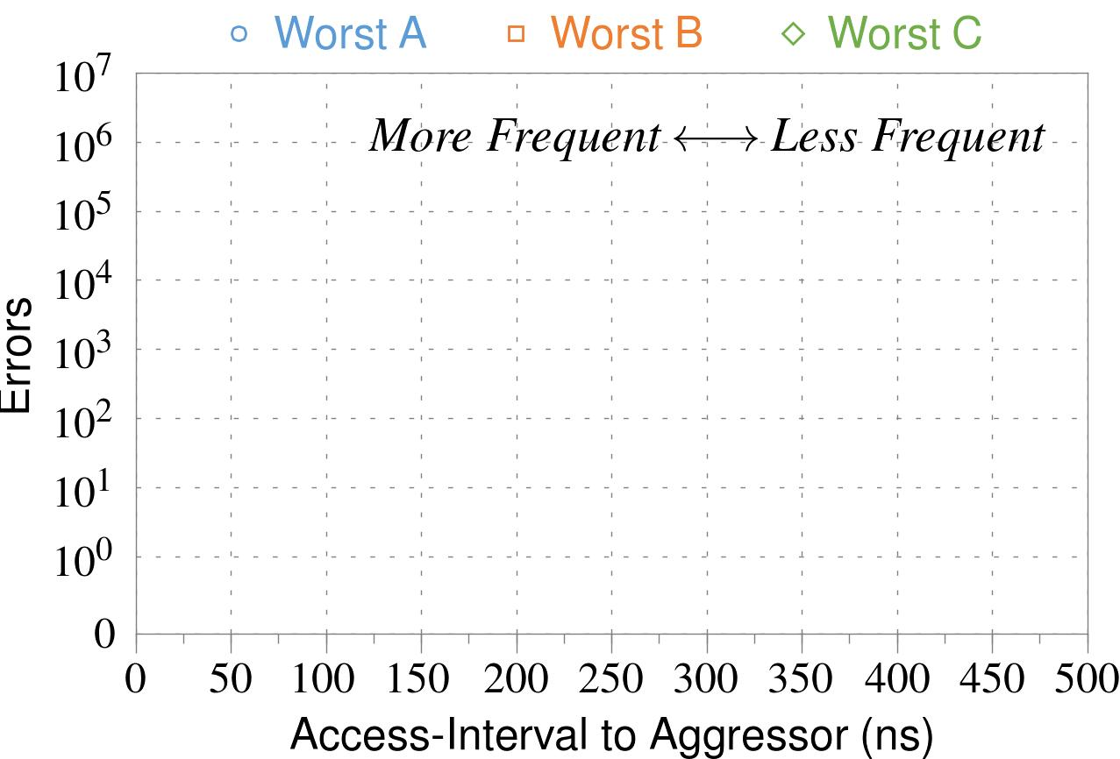
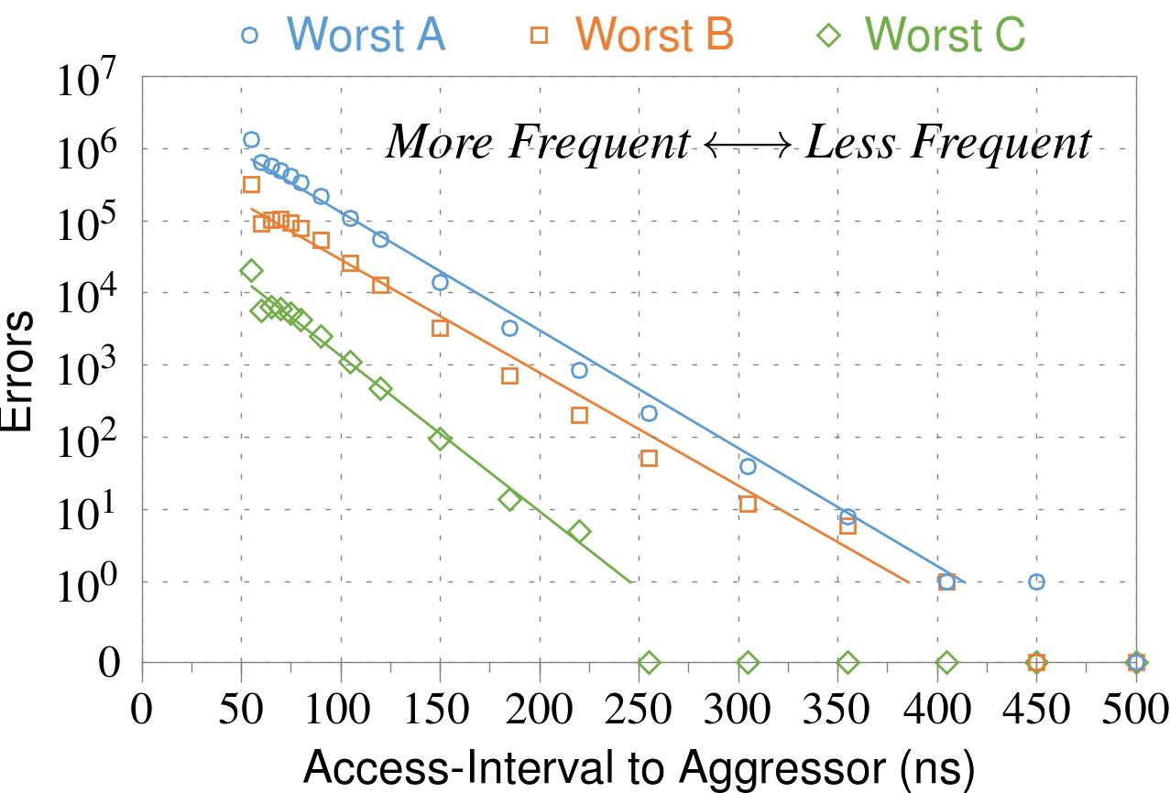
❶ Access-Interval (Aggressor)
Not Allowed
500ns
55ns
Note: For three modules with the most errors (only first bank)
Less frequent accesses → Fewer errors
1
Notes:
In this figure, the x-axis is the interval at which we access the aggressor. And the y-axis is the number of errors. To comply with the DRAM standard, we employ a default value of 55ns in our experiments. However, as we increase the access-interval, we see that the number of errors decreases. In particular, at 500ns, there are no errors for all three modules.
From this, we conclude that less frequent accesses induce fewer errors.
1

Slide 25
5. Sensitivity Studies
time
Test Row 0
Test Row 1
Test Row 2
···
Fill Module
with Data
Open
Open
···
Find Errors
in Module
Refresh Periodically
❶
Access-Interval: 55–500ns
❷
Refresh-Interval: 8–128ms
❸
Data-Pattern: all ‘1’s, all ‘0’s, etc.
1
Notes:
Now let’s take a look at the effect of varying the second test parameter: the refresh-interval.
1

Slide 26
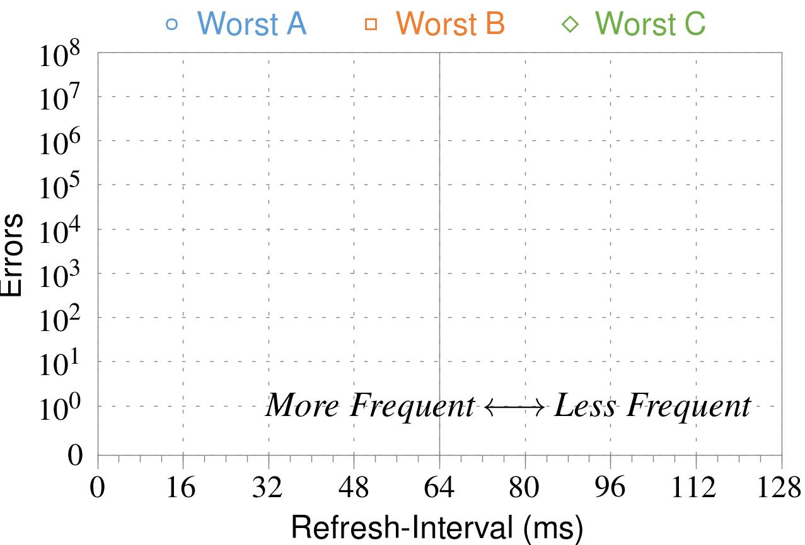
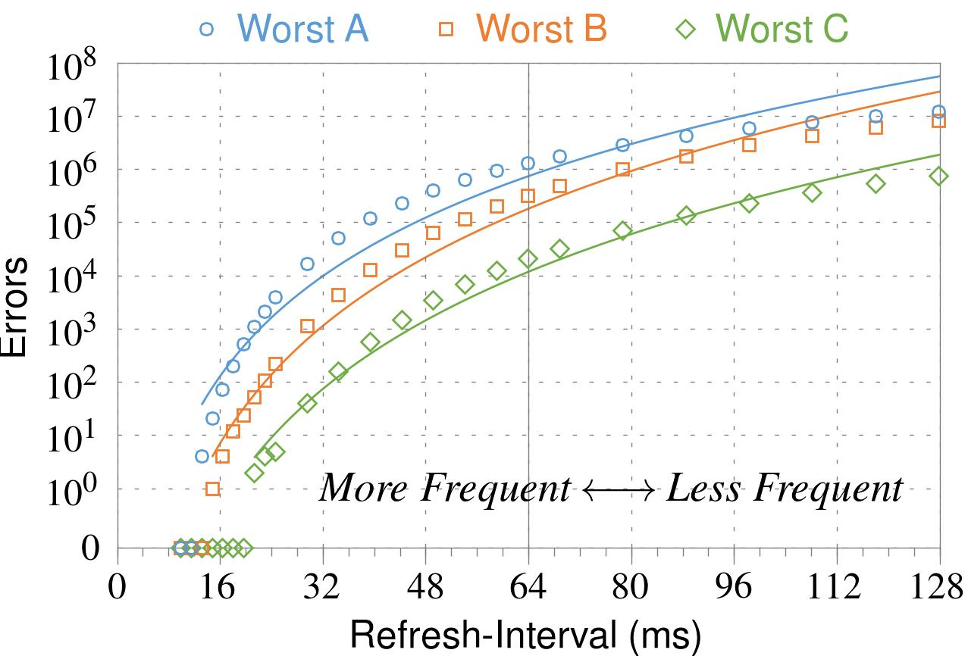
❷ Refresh-Interval
~7x frequent
64ms
Note: Using three modules with the most errors (only first bank)
More frequent refreshes → Fewer errors
1
Notes:
In this figure, the x-axis is the refresh-interval. And the y-axis is the number of errors. To comply with the DRAM standard, we employ a default value of 64ms in our experiments. However, as we decrease the refresh-interval, we see that the number of errors decreases. In particular, when the refresh is shortened by 7x, there are no errors for all three modules.
From this, we conclude that more frequent accesses induce fewer errors.
1

Slide 27
5. Sensitivity Studies
time
Test Row 0
Test Row 1
Test Row 2
···
Fill Module
with Data
Open
Open
···
Find Errors
in Module
Refresh Periodically
❶
Access-Interval: 55–500ns
❷
Refresh-Interval: 8–128ms
❸
Data-Pattern: all ‘1’s, all ‘0’s, etc.
1
Notes:
Now let’s take a look at the effect of varying the third test parameter: the data-pattern.
1

Slide 28
❸ Data-Pattern
Solid
RowStripe
111111
111111
111111
000000
111111
111111
10x Errors
111111
000000
~Solid
~RowStripe
000000
000000
000000
111111
000000
000000
000000
111111
Errors affected by data stored in other cells
1
Notes:
We tested the modules with four different data-patterns: Solid, inverse Solid, RowStripe, and inverse RowStripe. Solid and inverse Solid give us full coverage since each cell is tested with both 1s and 0s. And the same applies to RowStripe and its inverse.
However, we found that the rowstripe pattern had 10 times as more errors than the solid pattern. We also tested many other data-patterns, including random, but found RowStripe to induce the most errors.
Therefore, we conclude that errors are affected by data stored in other cells due to differences in coupling effects between the cells.
1

Slide 29
Naive Solutions
❶ Throttle accesses to same row
Limit access-interval: ≥500ns
Limit number of accesses: ≤128K (=64ms/500ns)
❷ Refresh more frequently
Shorten refresh-interval by ~7x
Both naive solutions introduce significant overhead in performance and power
1
Notes:
Based on what we learned from the sensitivity studies, there are two naive solutions that immediately present themselves.
First, we can throttle accesses to the same row. If the access-interval is greater than 500ns, I showed how errors are not induced. We can achieve the same effect by limiting the maximum number of accesses to the same row to be less than 128K, within a refresh interval.
Second, we can refresh the module more frequently. If the refresh-interval is shortened by 7x, I showed how errors can be prevented.
However, both naive solutions introduce significant overhead in both performance and power. Later on, I will propose a much more efficient solution.
1

Slide 30
Characterization Results
Most Modules Are at Risk
Errors vs. Vintage
Error = Charge Loss
Adjacency: Aggressor & Victim
Sensitivity Studies
Other Results in Paper
1
Notes:
Now that I have presented the five major characterization results, I will go on to describe briefly several other results we have in the paper.
1

Slide 31
6. Other Results in Paper
Victim Cells ≠ Weak Cells (i.e., leaky cells)
Almost no overlap between them
Errors not strongly affected by temperature
Default temperature: 50°C
At 30°C and 70°C, number of errors changes <15%
Errors are repeatable
Across ten iterations of testing, >70% of victim cells had errors in every iteration
1
Notes:
First, we show that victim cells are not weak cells, which are cells that are inherently leaky. According to our experiments, we saw almost no overlap between them.
Second, we show that errors are not strongly affected by temperature. In all of the tests so far, we set the temperature to 50 degrees Celsius. But even when we changed the temperature by 20 degrees, the number of errors changed by less than 15 percent.
Third, we show that errors are repeatable. Across ten iterations of testing, more than 70% of victim cells had errors in every iteration.
1

Slide 32
6. Other Results in Paper (cont’d)
As many as 4 errors per cache-line
Simple ECC (e.g., SECDED) cannot prevent all errors
Number of cells & rows affected by aggressor
Victims cells per aggressor: ≤110
Victims rows per aggressor: ≤9
Cells affected by two aggressors on either side
Very small fraction of victim cells (<100) have an error when either one of the aggressors is toggled
1
Notes:
Fourth, we show that there are as many as four errors per cacheline. From this, we conclude that simple ECC schemes (for example, SECDED) cannot prevent all errors.
Fifth, we show that the number of cells & rows affected by an aggressor can be as high as 110 or 9, respectively.
Lastly, we show that a very small fraction of victim cells experience an error when either one of the aggressors is toggled.
1

Slide 33
1. Historical Context
2. Demonstration (Real System)
3. Characterization (FPGA-Based)
4. Solutions
1
Notes:
Now I present solutions.
1

Slide 34
Several Potential Solutions
Cost
Make better DRAM chips
Power, Performance
Refresh frequently
Cost, Power
Sophisticated ECC
Cost, Power, Complexity
Access counters
1
Notes:
Here is a list of four potential solutions to disturbance errors: making better DRAM chips, refreshing more frequently, employing sophisticated ECC schemes, and using hardware counters to track the number of accesses to different rows.
However, all of these solutions incur a large overhead in terms cost, power, performance, and/or complexity.
1

Slide 35
Our Solution
PARA: Probabilistic Adjacent Row Activation
Key Idea
After closing a row, we activate (i.e., refresh) one of its neighbors with a low probability: p = 0.005
Reliability Guarantee
When p=0.005, errors in one year: 9.4×10-14
By adjusting the value of p, we can provide an arbitrarily strong protection against errors
1
Notes:
We provide a more efficient solution, called PARA, which stands for probabilistic adjacent row activation.
The key idea is thus: after closing a row, we activate (i.e., refresh) one of its neighbors with a low probability, for example, p equal to 0.005.
PARA provides a strong reliability guarantee even under the worst-case access patterns to DRAM. When we set p to 0.005, the expected number of errors in one year is 9.4 times 10 to the negative 14. This probability is much lower the failure rate of other hardware components, for example, the hard-disk drive.
And by adjusting the value of p, PARA can provide an arbitrarily strong-degree of protection against errors.
1

Slide 36
Advantages of PARA
PARA refreshes rows infrequently
Low power
Low performance-overhead
Average slowdown: 0.20% (for 29 benchmarks)
Maximum slowdown: 0.75%
PARA is stateless
Low cost
Low complexity
PARA is an effective and low-overhead solution to prevent disturbance errors
1
Notes:
PARA has many advantages. Since it refreshes row infrequently, it has low power and low performance-overhead. Simulated across 29 benchmarks, we saw an average of only 0.2% slowdown and a maximum of only 0.75% slowdown.
In addition, due to its stateless nature, PARA has low cost and complexity.
Therefore, PARA is an effective and low-overhead solution to prevent disturbance errors.
1

Slide 37
Conclusion
Disturbance errors are widespread in DRAM chips sold and used today
When a row is opened repeatedly, adjacent rows leak charge at an accelerated rate
We propose a stateless solution that prevents disturbance errors with low overhead
Due to difficulties in DRAM scaling, new and unexpected types of failures may appear
1
Notes:
Now I conclude the talk. We demonstrated that disturbance errors widespread in DRAM chips sold and used today.
We showed that when a row is opened repeatedly, adjacent rows leak charge at an accelerated rate.
We proposed a stateless solution, PARA, that prevents disturbance errors with low overhead.
We have exposed a real manifestation of the difficulties in DRAM scaling. And as these effects are exacerbated, new and unforeseen types of failures may appear in the future. And we believe that exposing these issues to the computer architecture community is the first step toward enabling better solutions.
<number>

Slide 38
Result: rowhammer-test
https://github.com/google/rowhammer-test
Runs in userland
Allocates 1GB, looks for bit flips in this
Risky: Could corrupt other processes or the kernel
In practice, it rarely does
Notes:
Thank you, I’ll take questions.
<number>

